Slide 1


Background
More widespread and mainstream
Introduction of Central Bank Digital Currencies
Current financial system outdates using legacy methods such as SWIFT
Australian Banks exploring the use of blockchain technology to settle payments
In 2021 it was estimated 28% of Australians own or have owned cryptocurrency
Notes:
Crypto and blockchain tech are now more mainstream. Rosie Rios, former US treasurer, said "Crypto has already left the station" when she joined Ripple's board in 2021, indicating that adoption of these technologies is irreversible. Governments globally are considering a cashless society and introducing central bank digital currencies, moving away from outdated tech like SWIFT, which is slow and expensive. Blockchain could improve banking, and banks like CBA in Australia are exploring this. A report in Dec 2021 by The Independent Reserve Cryptocurrency Index found 28% of Aussies owned or had owned cryptocurrency.

Slide 2

The Issue to be Investigated
Can we use NLP to predict XRP price movement?
Who could benefit?
Can be used as a possible tool for buying/selling indicator for investors given the sheer volume of social media posts
Why XRP?
High media coverage
Active community
Substantial market presence (Top 10 coin by market cap)
Not to be used as financial advice
Notes:
As more Australians invest in cryptocurrency and it becomes mainstream, many will want to buy or sell signals. However, forums have over 35,000 posts, making it hard to extract useful insights without data science skills. To address this, we'll explore using NLP sentiment analysis to predict price movement for a defined period using the long short term memory model, which has shown promise for coins like ETH and BTC. We'll focus on one coin of interest in the community, given its active community, substantial market presence, and ongoing development. This will help us determine if previous models apply to other coins and contribute to current research.

Slide 3
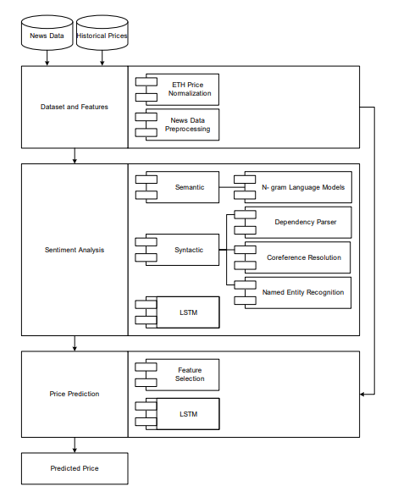
What studies have been done in this space?
There are various studies which utilise natural language processing to predict price movement of cryptocurrencies (Vo, 2019; Lahmiri & Bekiros, 2019; Kang et al., 2022; Shahzad et al., 2021)
Many focus around BTC and ETH
Most have utilised Recurrent Neural Network to feed in sentiment score to predict cryptocurrency price
Traditional methods to predict price include:
Fundamental method
Traditional technical analysis
Quantitative technical analysis
Figure: NLP model predicting price via RNN network using historical and news data ( ). A potential foundation for our model (Vo, 2019)
Notes:
There are many published papers which cite the use of sentiment analysis to attempt to predict price movement of cryptocurrencies, many studies limit their focus on a subset of the crypto space such as focusing on well-known coins such as BTC and ETH (116-MK032.pdf (ijke.org)). NLP can be applied to various inputs according to the literature such as news articles (116-MK032.pdf (ijke.org)) and even twitter sentiment analysis to predict price (BPTE: Bitcoin Price Prediction and Trend Examination using Twitter Sentiment Analysis | IEEE Conference Publication | IEEE Xplore). This gives us a foundation for developing our model.
Essentially there are three main methods used in financial markets to predict price movement.
Fundamental method: Economic features which influence price
Traditional technical analysis: To forsee what others are thinking based on price and volume of such cryptocurrency
Quantitative technical analysis: Focuses on more quantitative and statistical approaches such as moving averages, regression etc. New methods and breakthrough in technology has seen advancements in this space. Our proposed model falls into this category.

Slide 4
Proposed machine learning model
Long short-term memory (LSTM)
Has been successfully used in NLP and timeseries forecasting
Learns from the entire time series data, including the context around each data point which is a limitation of traditional neural networks which only process data in the forward direction (Coyne, 2022)
Has been shown to be highly efficient in forecasting chaotic and dynamic cryptocurrency markets compared to more vanilla NN (Lahmiri & Bekiros, 2019)
Hybrid models utilizing LSTM, GRU, and GRU-TCN showed better RMSE than LSTM alone for ETH price prediction when increased complexity was applied (Kang et al., 2022)
Limitations
Higher computational burden
Overfitting if data is noisy or limited
Notes:
A review of the literature demonstrates a recurring theme in relation to NLP and predicting cryptocurrency price, and that is the Long short term memory model which is a form of recurrent neural network. Unlike traditional neural networks the long short term memory model is able to learn from the entire time series data when making a prediction, instead of just focusing in a forward direction. Many studies cite that the benefit of the long short term memory network is that it is highly efficient in forecasting chaotic and dynamic time series data which we know cryptocurrency can be. Though other studies have demonstrated that the model can be improved through employing a hybrid model approach by increasing model complexity. All sources state that a major limitation of this model though is the higher computational processing quired to train, with overfitting common with noisy data or limited data.

Slide 5
Collecting Language Data
Platform | Brief Description | Cloudflare protected | TOS Regarding data gathering
Reddit r/CryptoCurrency | General cryptocurrency discussion | No | Email sent requesting prior permission to scrape website as per ToS
Reddit r/Ripple | Ripple and XRP-specific | No | Email sent requesting prior permission to scrape website as per ToS
Reddit r/CryptoMarkets | Cryptocurrency trading market analysis and discussion | No | Email sent requesting prior permission to scrape website as per ToS
Investing.com | Contains discussion board around XRP – Conversation | No | Email sent requesting prior permission to scrape website as per ToS. Note: ToS state that scrapping is prohibited for user information and not other info
Yahoo finance | Contains discussion board around XRP – Conversation | No | Not mentioned in ToS or community guidelines
We want to collect vast amount of data from both novice, intermediate and experienced investors, this will help capture a better representative of overall sentiment and overcome limitations
Different perspectives
Different investment behaviours
Different richness of information
Notes:
We aim to collect data from various sources for our model, starting with a wide scope to overcome issues and have contingencies in place. We want our model to capture novice, intermediate, and experienced investors to capture different perspectives and behaviors to overcome limitations and biases which could occure through focusing on one user type by having a representive corpus. We reviewed several websites with forum boards dedicated to XRP/Ripple, and found that none of them employ cloudfare protection. However, some prohibit website scraping, which may require permission or legal advice. We reached out to Reddit and Investing.com for permission with investing.com replying that it is okay to scrape and use for personal use.

Slide 6
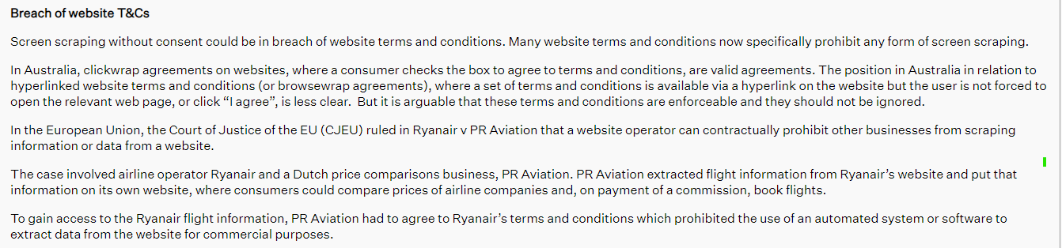
legal considerations
https://advertisingcouncil.org.au/news/risky-business-is-screen-scraping-legal/
Notes:
Even if Cloudflare technology is absent, website owners often use legal tools such as ToS to protect their content from unauthorized scraping. ToS are contracts between the website owner and the user, and they often include provisions that prohibit scraping or other forms of data extraction. We see below that many legal firms in Australia highlight that ToS as valid agreements which must be adhered to even despite scrapping is not in itself illegal, hihgltiging the complex nature of ToS and the ToS debate as cited by

Slide 7
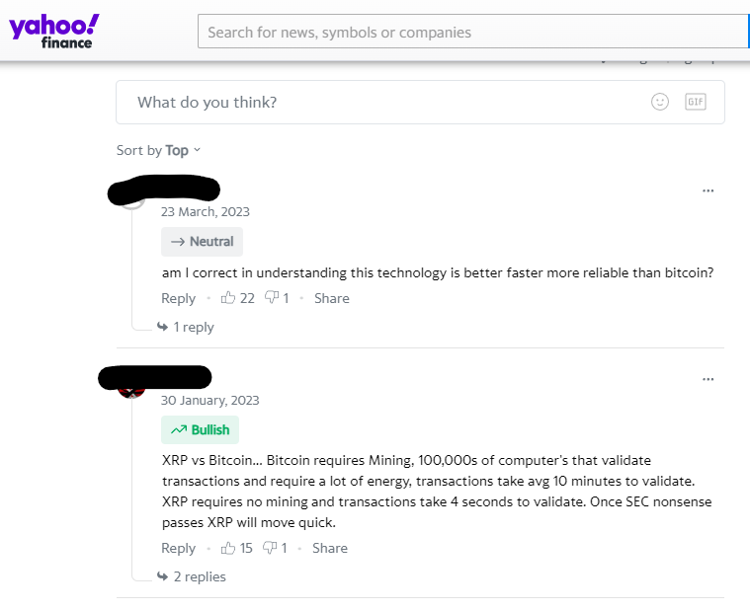
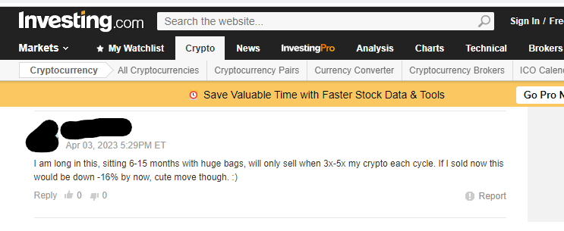
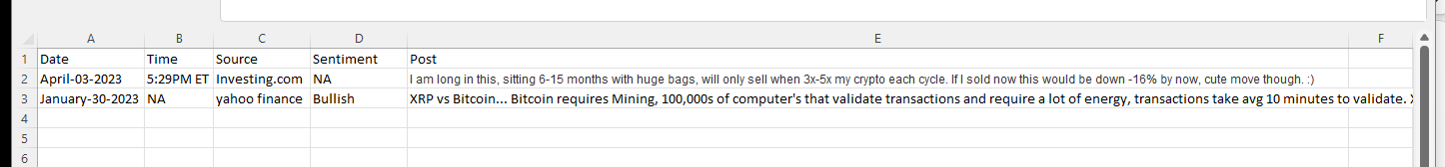
Collecting and aggregating forum data
Notes:
In this example, we showcase how we can potentially store the data we gather from multiple sources, such as Yahoo Finance and Investing.com, by utilizing web crawling and scraping techniques. Our main objective is to acquire data related to a forum post, which includes details such as date, time, source, and sentiment (if available), along with the post content itself. We have observed that each website may offer different sets of data, with some sources lacking certain information, such as the post time. Moreover, some websites may also provide additional insights, such as the user's sentiment towards a particular cryptocurrency, such as bullish, neutral, or bearish. However, we must ensure that we do not scrape any personal information, such as the username or name of the poster as this is mentioned in the ToS on some websites.

Slide 8
Collecting Historic Price Data
Platform | Brief Description | Cloudflare protected | TOS Regarding data gathering
https://www.coingecko.com/ | Can search on date range for XRP-USD price, allowing us to obtain open and close value | No | Non-Interference: You undertake that you shall not howsoever mine data from, scrape… Note: We can download data as CSV extract, contains price at 00:00:00 UTC only APIs are available
Finance.yahoo | Can search on date range for XRP-USD price, allowing us to obtain open, high, low, close, adjusted close and volume. Histroic data from 2017 | No | Not mentioned in ToS or community guidelines. Note: We can download the data as CSV extract
https://coinmarketcap.com/ | Can search on date range for XRP-USD price, allowing us to obtain high, low, close and open value. Though date range is much more limited | No | Prohibited Activities: any data mining, crawling, "scraping", robot or similar automated or data gathering… Note: APIs are available
Cryptocurrency is traded 24/7 unlike the traditional stock market.
Open appears to be based on UTC time
Close appears to be based on UTC time
Price will be in USD currency to avoid conversion issues and changes in currency exchange rates
High and low also avaible
Notes:
We also need historic price data for XRP, for this we will most likely use finance yahoo as it allows us to obtain historic data from 2017 onwards and does not prohibit website scrapping and does not utilise cloud fare technology. In addition, contains more data then coingecko and coinmarket cap.

Slide 9
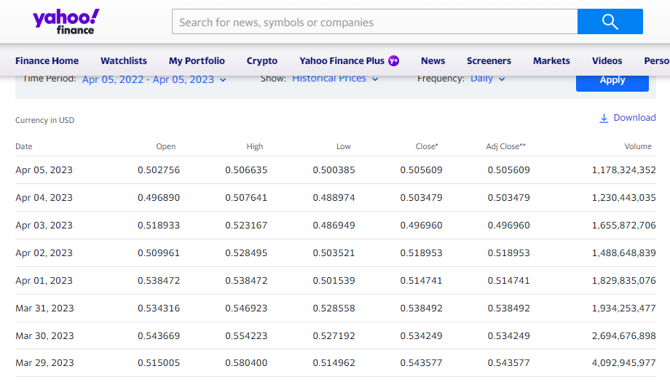
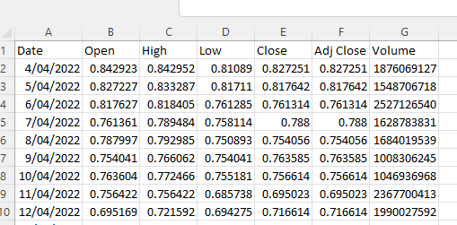
Collecting and historic price data

Slide 10
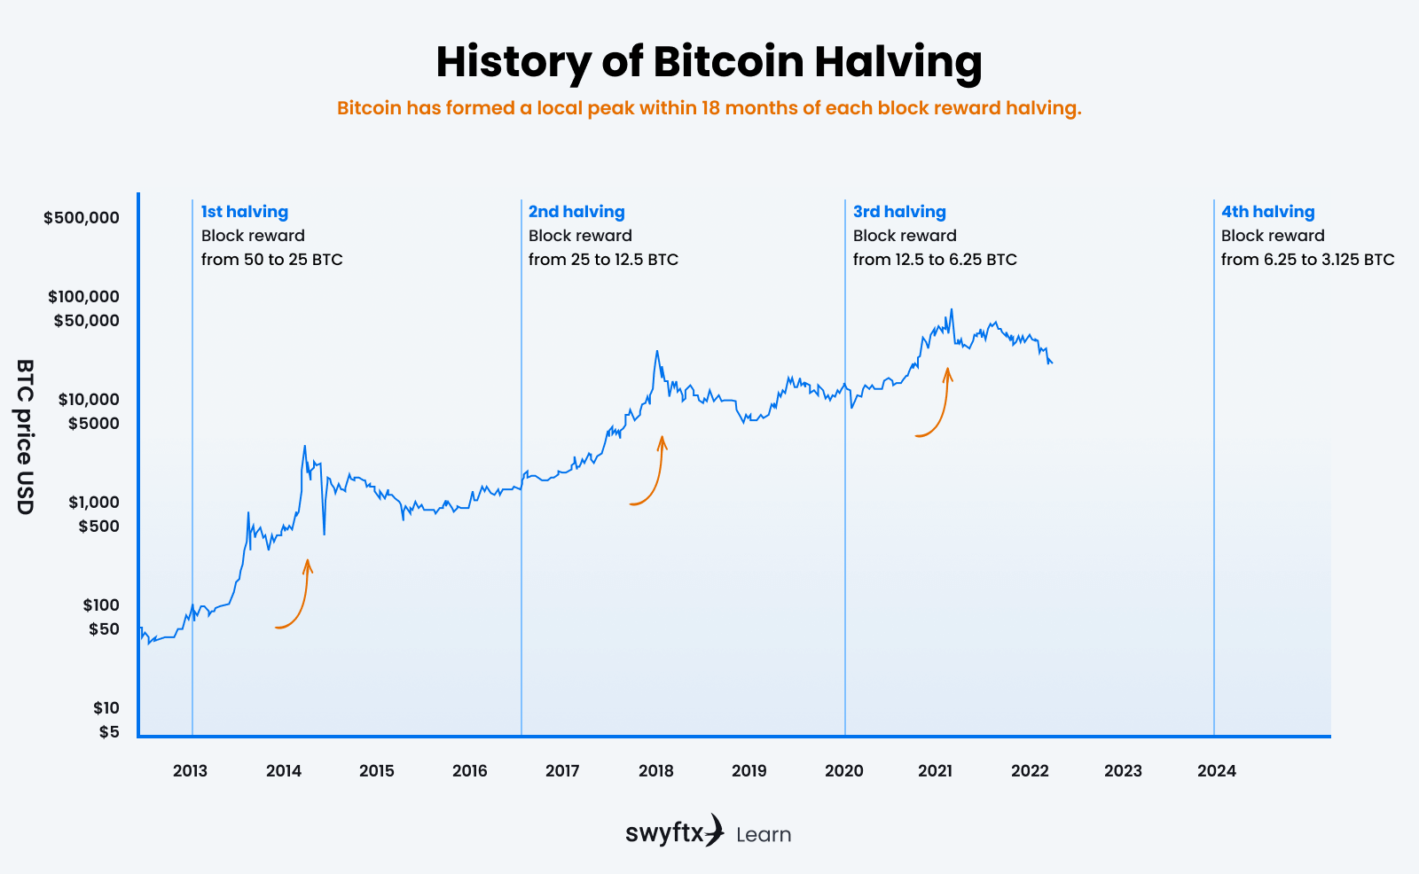
Considerations
What is our period of analysis?
1 bitcoin cycle
Notes:
When we start gathering our data, we will need to define a period of our analysis, crypto is a volatile asset with many coins following the bitcoin cycle which is 4 years. Historically this cycle involves accumulation, markup, distribution and markdown. This 4 year cycle tends to following the bitcoin halving, which occurs when the reward for bitcoin transactions is cut in half, which reduces the rate at which new coins are created and thus lower availability of new supply. Based on historic payment data it appears that we will be able to obtain at least around 5 years of data which represents one cycle.

Slide 11
Corpus Sampling and Methodologies
How big will our corpus need to be?
Many cite when collecting timeseries to forecast price granularity is important to capture intraday fluctuations (Hilpisch, 2015)
4 years * 365 days * 24 hours = 35,040 possible forum posts
Investing.com only has 35,000+ forum posts
Notes:
The most significant challenge we encountered was determining the ideal corpus size, as many of the studies we analyzed did not specify the size of their corpus. We consulted a financial textbook, which recommended having at least one data point per hour to capture intraday variation for forecasting purposes. To achieve this for a single bitcoin cycle, we would need a corpus of approximately 35,000 data points. However, we realized that the discussion board of investing.com alone contains only 35,000 posts, which may not be feasible to collect within our given time constraints and limited computational resources, especially considering the relatively short length of the texts; and in addition time of post is not always available on a website meaning we can’t confirm this approach.

Slide 12
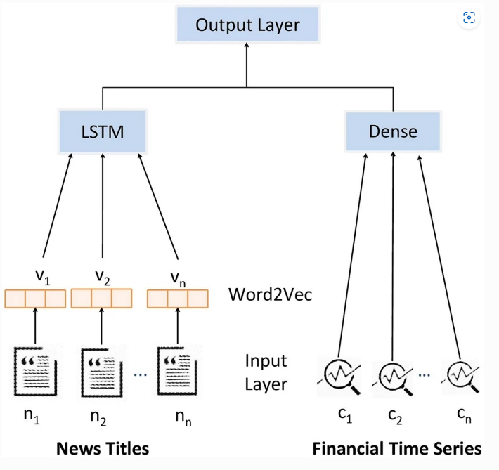
Corpus Possessing
Many studies have utilised vastly different approaches predicting crypto/stock prices via NLP
Pre-processing could include
Tokenization
Stop word removal
Stemming/lemmatization to normalise and remove noise
One approach
Word2Vec Vs Bag of Word
Slow to train
Dimension reduction
Figure: Study which employed Word2Vec to predict stock price (Chandola et al., 2022)
Notes:
After obtaining our corpus, the next step would be to preprocess and convert it so that it can be utilized in our long short-term memory network. However, we must exercise caution during this step since removing stop words can significantly alter the meaning of the text. For instance, "the product is not good" could become "product good" after stop words removal.
Once the preprocessing is complete, we must prepare the data for the model. According to a study, one effective method is to convert news titles using Word2Vec, which enables the algorithm to understand the context of the words in the text corpus. This approach is superior to the bag-of-words model, which treats each word as a separate entity and does not capture the relationships between them, which is crucial for our analysis. We also need to consider reducing the dimensions of the data since long short-term memory networks can be slow to train.

Slide 13

Potential Challenges and limitations Identified
Data quality and pre-processing
Ambiguity and context
Feature Selection
Model Selection and Optimisation
Ethical and legal considerations
Notes:
Data quality and pre-processing: Can we ensure that our data we collect is representative of the overall sentiment? We will try to mitigate this through using multiple forums to capture users from different platforms. More advance users will use investing websites, whilst more novice users will use social media platforms. This highlgiths a potential limitation in our corpus if we collect just one group as previously disccused
Ambiguity and context: We know crypto is full of informal language and jargon, for example too the moon is associated with growth. This use of Jaron means we must be cautious when employing NLP analysis as to ensure we can capture the meaning correctly. Thus we will need to ensure we can handle the domain of finance, techn and crypto
Feature selection
Model section
Ethical and legal considerations: As a data scientist we need to be aware of data gathering and scrapping. We seen previously that many websites prohibit this, though the law in Australia is complex as whilst acadmics are exepmpt to utilise copyright information, terms of services on websites still represent a contractual obligation. We are currently exploring this aspect and have seeked written permission from the websites

Slide 14
References
Lahmiri, S. and Bekiros, S. (2019) “Cryptocurrency forecasting with deep learning chaotic neural networks,” Chaos, Solitons &amp; Fractals, 118, pp. 35–40. Available at: https://doi.org/10.1016/j.chaos.2018.11.014.
Kang, C.Y., Lee, C.P. and Lim, K.M. (2022) “Cryptocurrency price prediction with convolutional neural network and stacked gated recurrent unit,” Data, 7(11), p. 149. Available at: https://doi.org/10.3390/data7110149.
Vo, A.-D. (2019) “Sentiment analysis of news for effective cryptocurrency price prediction,” International Journal of Knowledge Engineering, 5(2), pp. 47–52. Available at: https://doi.org/10.18178/ijke.2019.5.2.116.
Shahzad, M.K. et al. (2021) “BPTE: Bitcoin price prediction and trend examination using Twitter sentiment analysis,” 2021 International Conference on Information and Communication Technology Convergence (ICTC) [Preprint]. Available at: https://doi.org/10.1109/ictc52510.2021.9620216.
Coyne, A. (2022) Super Simple Neural Network for bitcoin price prediction in Python, Medium. Python in Plain English. Available at: https://python.plainenglish.io/super-simple-neural-network-for-bitcoin-price-prediction-in-python-8c2cd46d11a7 (Accessed: April 5, 2023).
Hilpisch, Y. (2015) Python for Finance Analyze Big Financial Data. Beijing: O'Reilly.

